Slide 1
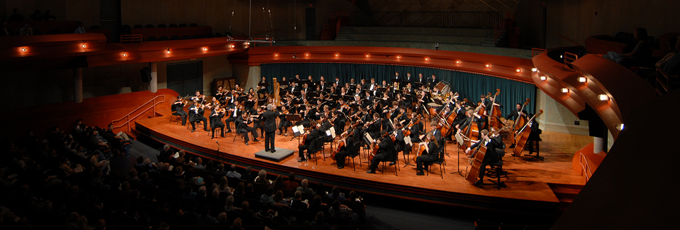
Introduction to ORCHESTRATION

Slide 2
Disclaimer!!
The content listed here based on personal experience and only for educational purpose

Slide 3
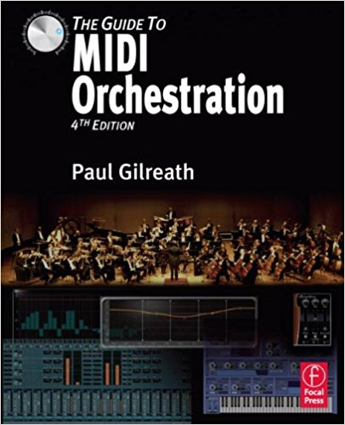
And this book…

Slide 4
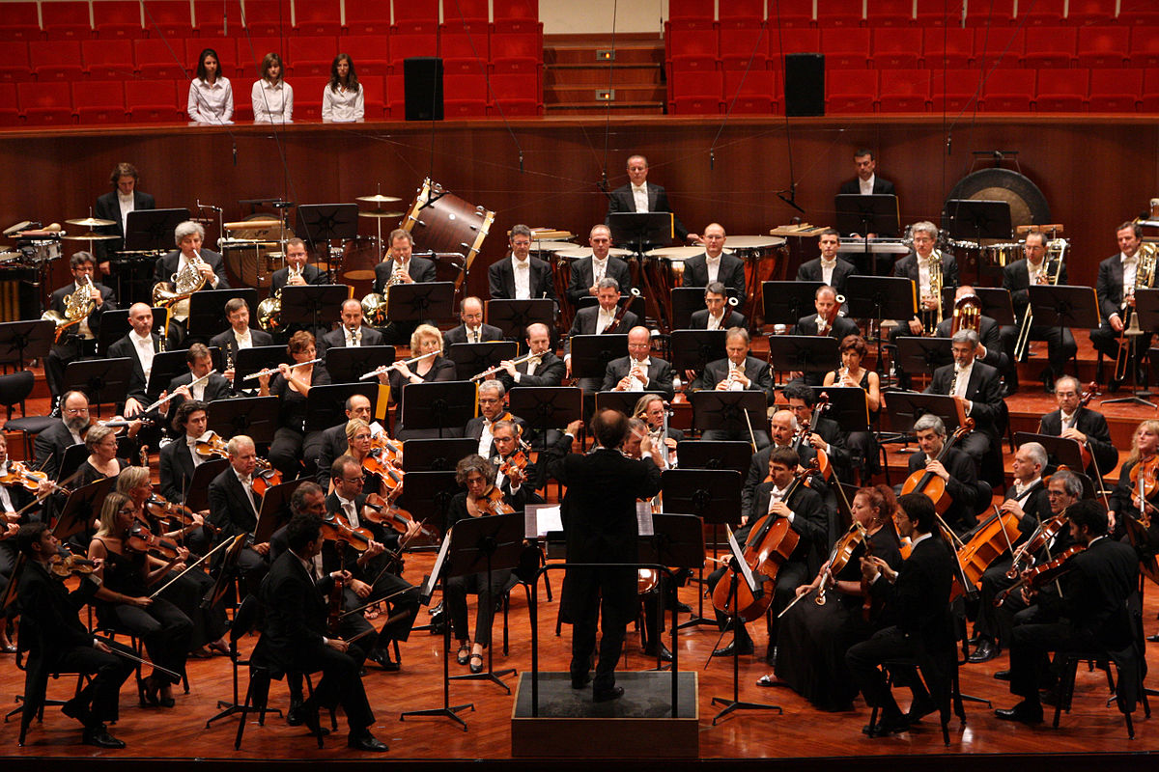
What we Gonna Learn
The Orchestra
Basic Orchestration and Composition
Working With DAW

Slide 5
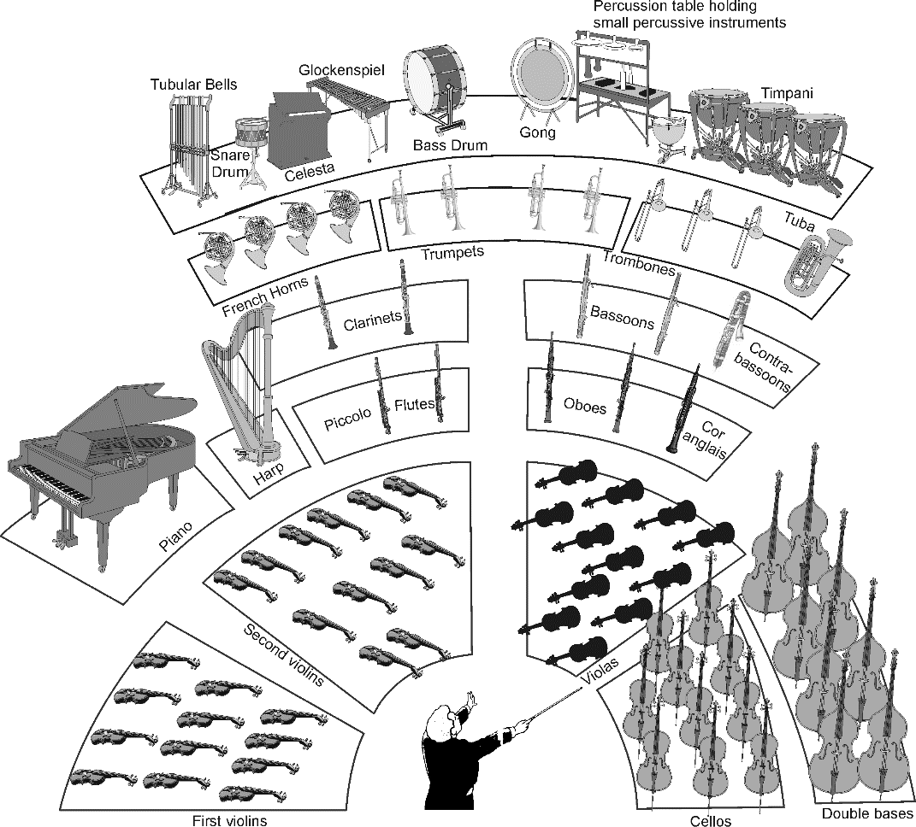
The Orchestra
Strings
Woodwinds
Brass
Percussions
Keys

Slide 6
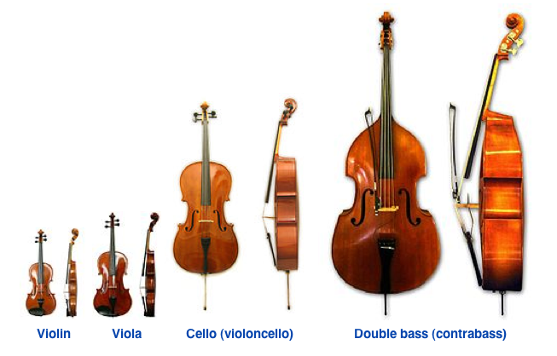
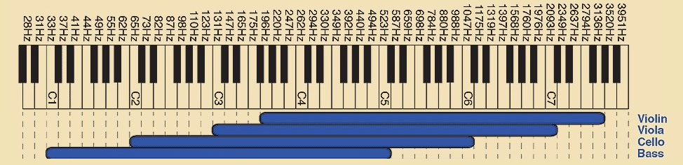
Strings
Violin I
Violin II
Viola
Cello
Double Bass

Slide 7
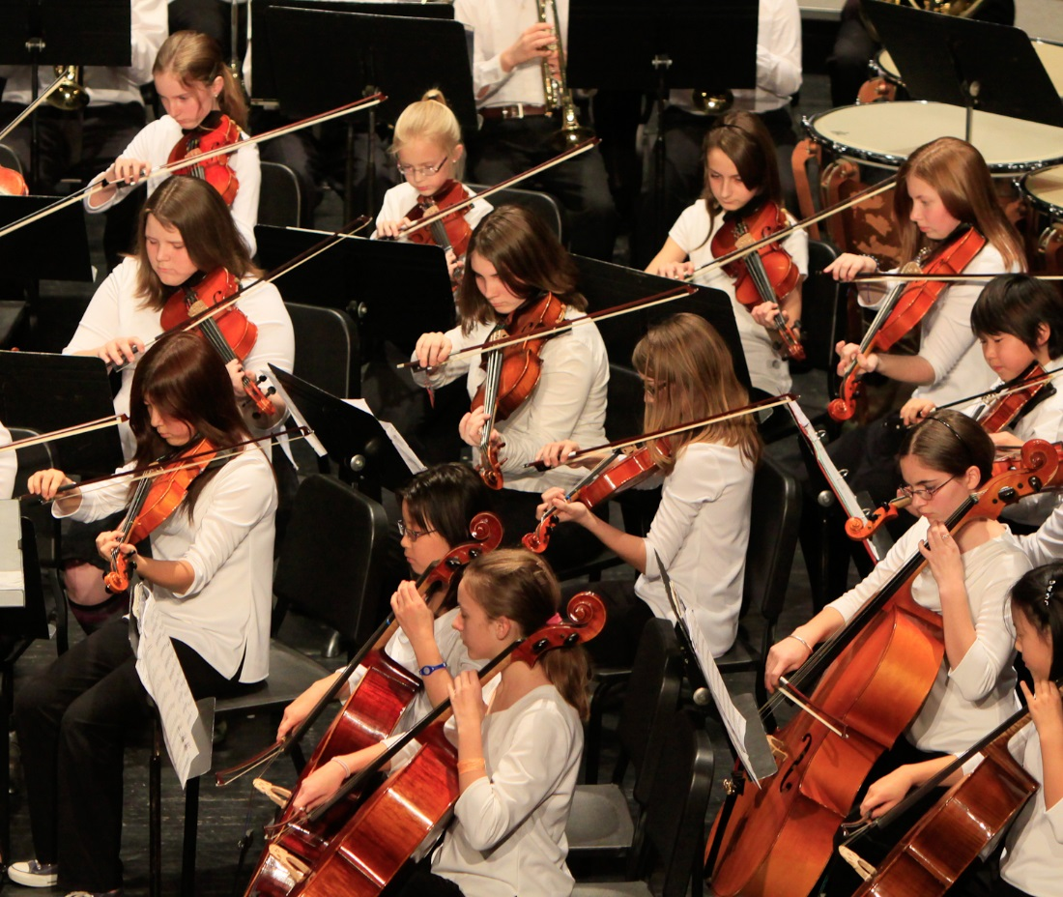
Strings articulation
Sustain
Staccato
Pizzicato
Marcato
Legato
Tremolo

Slide 8
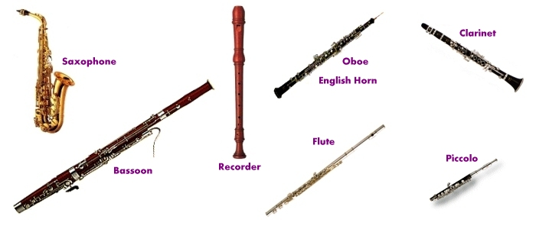
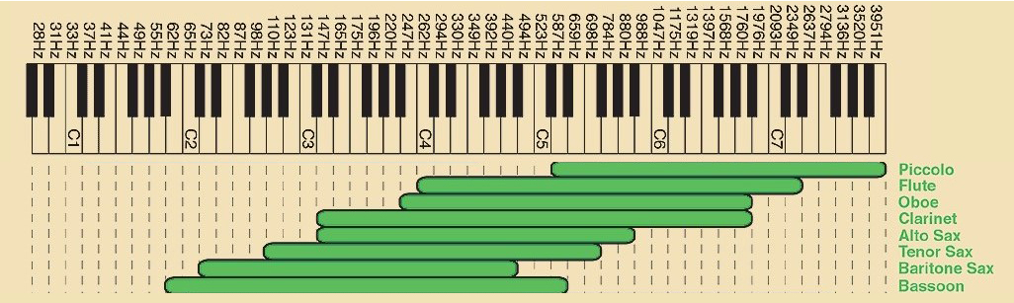
Woodwinds
Flute
Oboe
Clarinet
Recorder
Saxophone

Slide 9
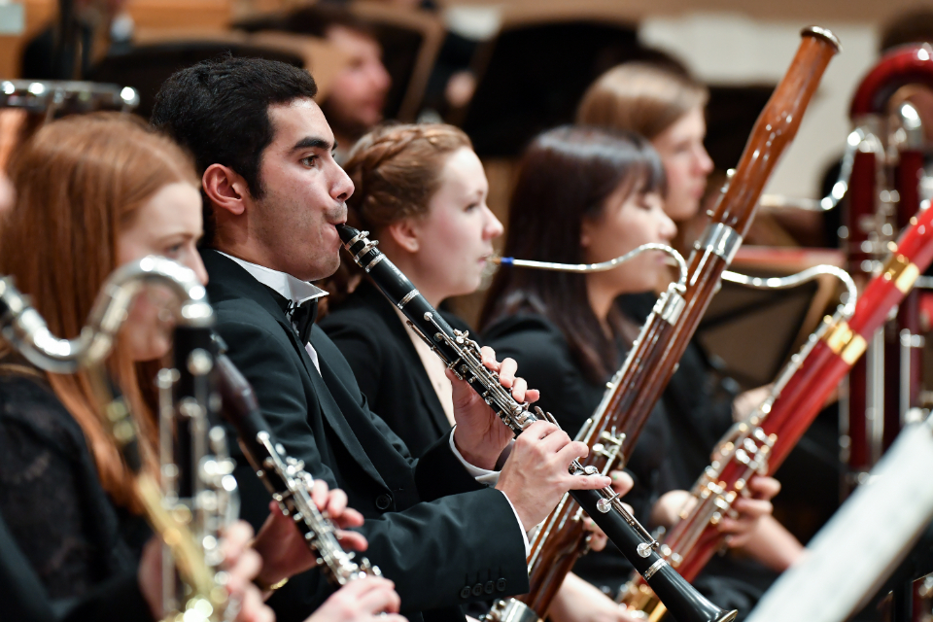
woodwinds articulation
Sustain
Staccato
Marcato
Legato
Vibrato

Slide 10
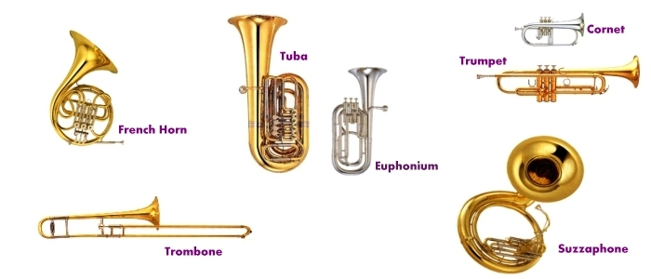
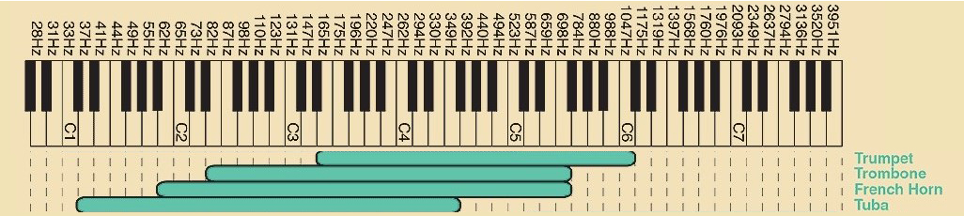
Brass
Trumpet
Trombone
Horn
Tuba

Slide 11
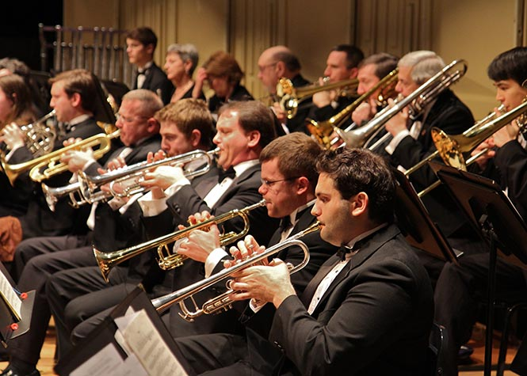
Brass articulation
Sustain
Staccato
Marcato
Legato
Vibrato
Mute

Slide 12
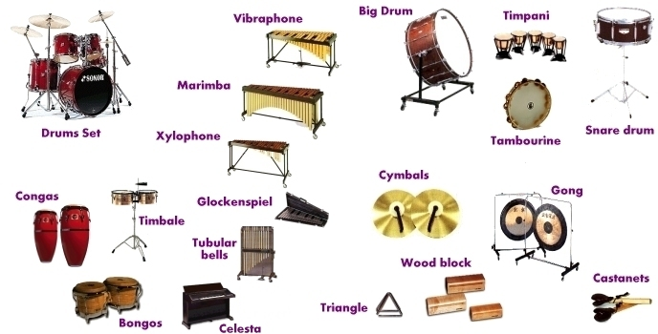
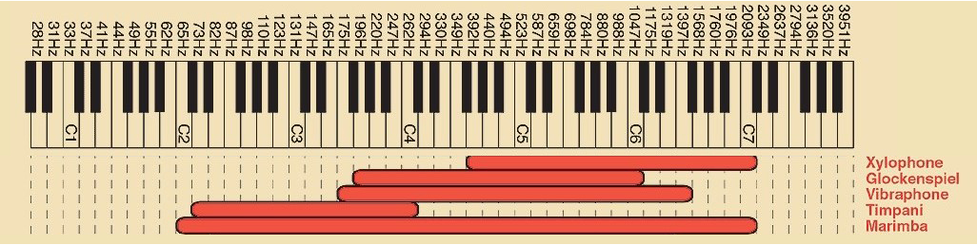
Percussion
Chromatic
Non-chromatic

Slide 13
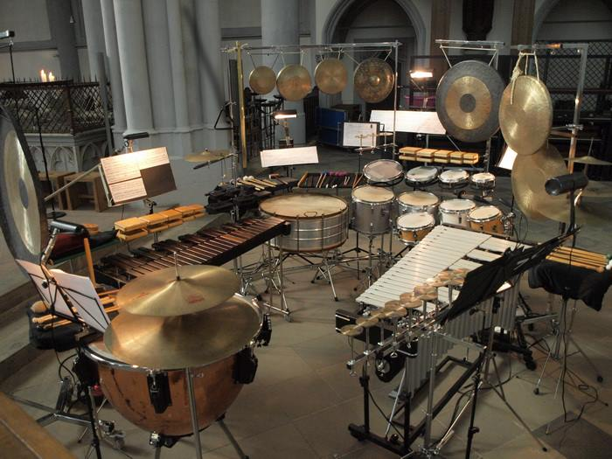
Percussion articulation
Tremolo
Suspended

Slide 14
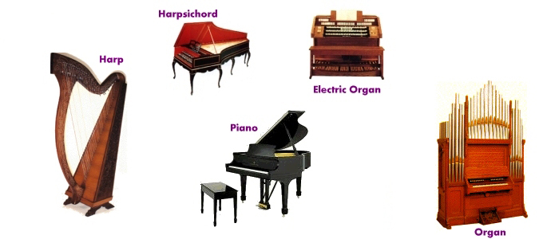
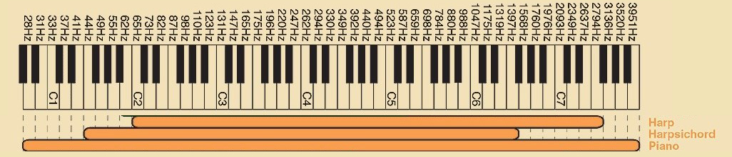
Keys
Piano
Organ
Harpsichord
Harp

Slide 15
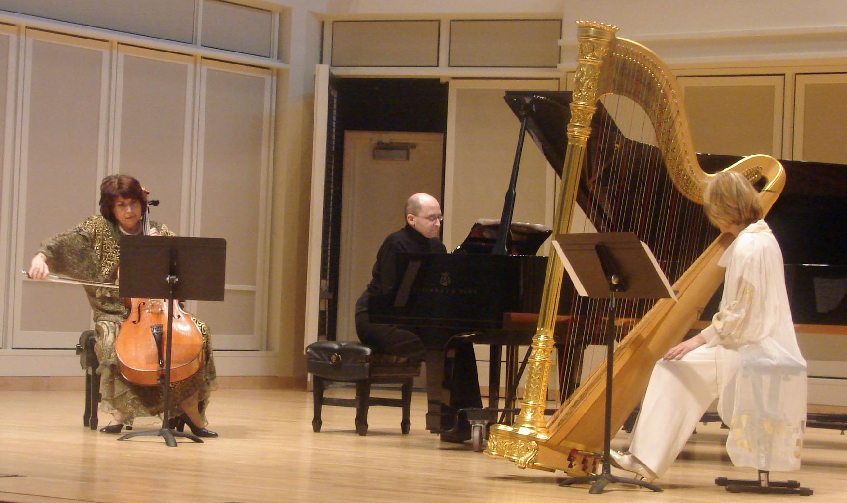
Keys articulation
Tremolo
Staccato
Sustain
Legato
Rolling

Slide 16
ANY Question?
That’s about the orchestra..
Let’s Continue…

Slide 17
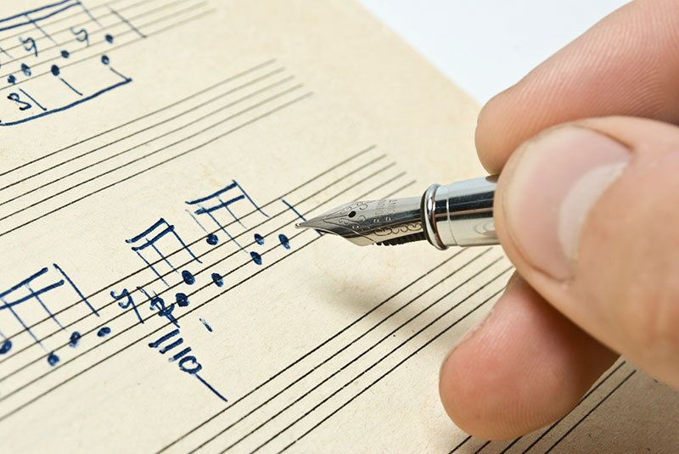
Basic Orchestration and Composition
Duality of Orchestral Composing
Elements of Orchestral Composition

Slide 18
Duality of orchestral composing
Compositional
Orchestrational
Style and mood
Length and complexity
Raison d’etre
Harmonic structure
Size of the orchestra
Orchestration style (classical, baroque, etc.)
Dynamics, timbre, and articulation

Slide 19
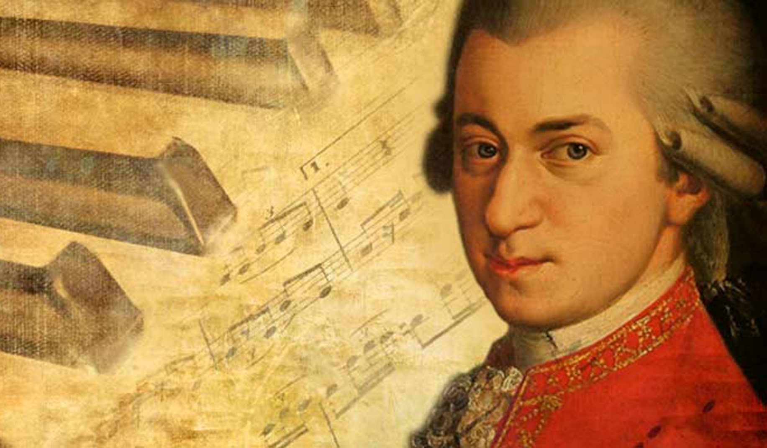
Orchestral Composition Elements
Primary
Secondary
Tertiary

Slide 20
Orchestral Elements functionality
Primary
Secondary
Tertiary
Main melody
Solo
Special effects
Countermelody
Special effects
Accompaniment
Background (Pads)
Accompaniment
Rhythmic
Doubling

Slide 21
Orchestral Elements functionality
Instrument | Description of solo sound | Usage
Violin Section | Beautiful, legato, intense, and soaring (in the top octave) | Works in almost all melodic situations. First and second violin sections can play in unison to produce a larger and louder sound
Viola Section | Beautiful, thick, unusual, intense in the top octave | Adds an unusual and different character in solo section and a thickness when used in unison with the violins. Also good for doubling an octave below the violins
Cello Section | Lyrical and warm in the middle range, brilliant and intense in the top octave | Great for use as a solo section that requires a very lyrical or intense feel. Can be used to double viola or violins at the unison, octave, or double octave

Slide 22
Orchestral Elements functionality
Instrument | Description of solo sound | Usage
Flute | Sweet and lyrical; open with a singing quality; tender in soft passage | Use when a lyrical, singing quality is required. Works well for beautiful melodies and sprightly, active melodies
Oboe | Intense, melancholy, poignant, heartfelt, sad, plaintive | Use when you need to cut through a background easily (due to its nasal quality). Works especially well with string accompaniment. Melodies with repeated notes are idiomatic
Clarinet | Open, very expressive, intense in the upper range | Works well as a solo instrument in very expressive phrases with long notes
English Horn | Melancholy, thick, plaintive | Use is similar to oboe though less used
Bassoon | Playful, lyrical, beautiful, and clear | Use as an unusual instrument for melody that needs to cut through background. Less nasal than oboe

Slide 23
Orchestral Elements functionality
Instrument | Description of solo sound | Usage
French Horn Solo | Introspective, round, incredibly emotional, beautiful, heartfelt; intense at higher octave even in softer dynamics | Excellent for beautiful melodies, also great for secondary melodies and “comments” at the end of primary phrase played by another instrument or section
Trumpet Solo | Introspective and thoughtful in soft dynamics. Stoic in louder passages. Can sound militaristic in proper contexts. | Exciting, creates an anticipatory effect. Use in soft passages cause a pensive or reflective feel. In loud passages it is strong and aggressive

Slide 24
Orchestral Elements functionality
Instrument | Description of solo sound | Usage
French Horn Section | Thick and full in soft dynamics, heroic and incredibly intense in unison, unlike any other sound in orchestra | Use in soft passages for a quiet but thick melodic line. In unison at loud dynamics, use for very strong lines that can be heard over the entire orchestra
Trumpet Section | Powerful, bold, and exciting | Typically used in louder passages in which they sound intense and powerful
Trombone Section | Strong and powerful | Often used for long sustained but powerfully articulated melodies below a cacophony of sound above

Slide 25
Example of working composition of orchestral elements
Primary | Secondary | Tertiary
Violins | Oboe | Strings
Violins | Clarinet | Strings
Violins | Solo or section French Horns | Strings
Trumpet | Violins | Strings
Horn | Violins | Strings
Flute | Oboe | Strings
Flute | French Horn | Strings

Slide 26
ANY Question?
That’s about orchestration and composition..
Let’s Continue…

Slide 27
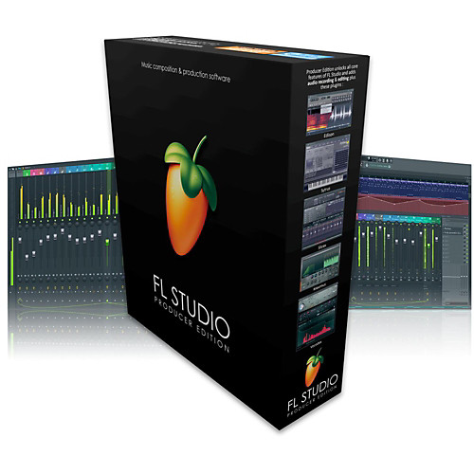
Working with DAW
Sequencing techniques
Effects
Mixing Orchestra

Slide 28
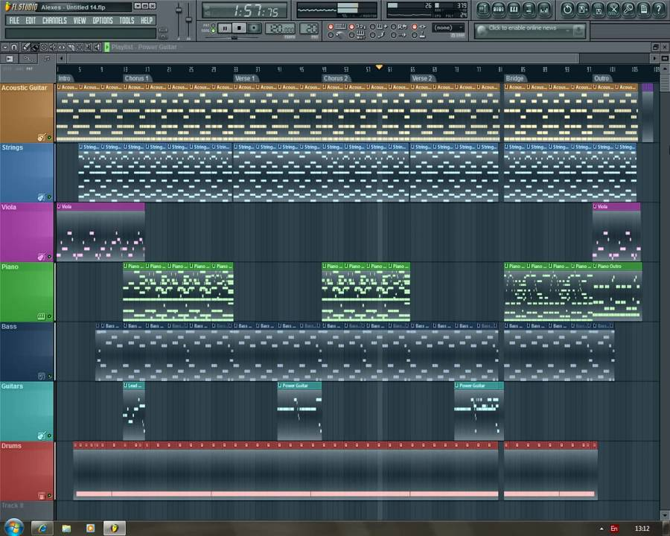
Sequencing techniques
Velocity
Envelope
Volume
Expression
Articulation
Breath (winds & brass)

Slide 29
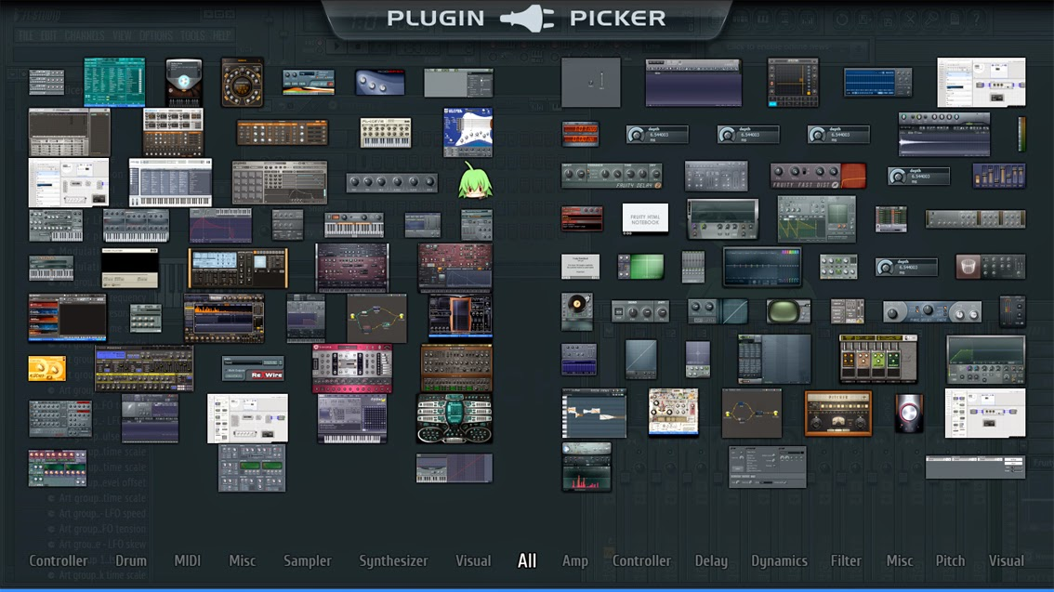
Effects
Reverb
Delay
Compressor
Limiter
Stereo Shaper
Chorus

Slide 30
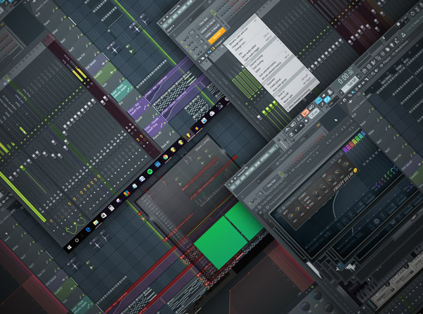
Mixing Orchestra
Panning
Equalizer
Volume

Slide 31
ANY Question?
That’s about working with DAW..
Let’s Continue…

Slide 32

Discord.gg/Bkwux5X
Music Production Learning Community

Slide 33
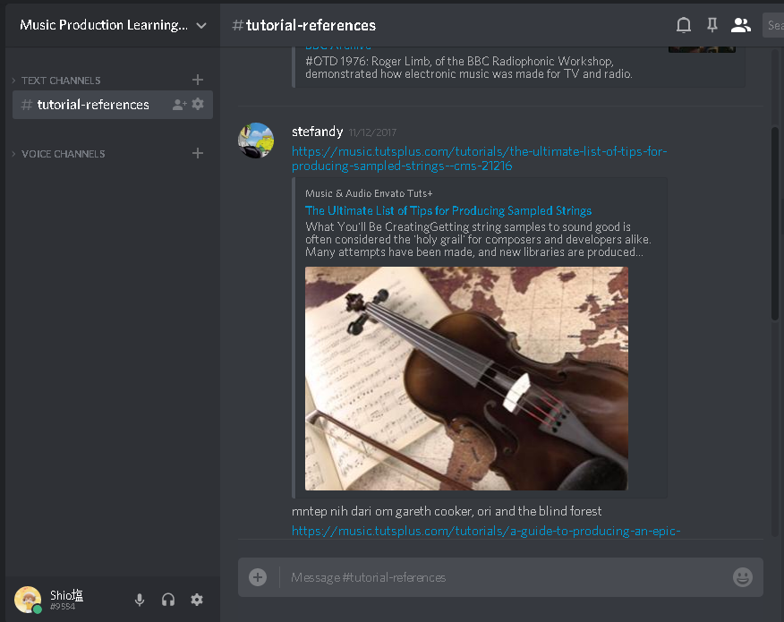
MPLC
Community
Challenge
Collaboration

Slide 34
Thank you
And Don’t Forget!!
Sound Design Class on NEXT WEEK!!

